Slide 1



PROGRAMMING FUNDAMENTALS IN C
Recursion

Slide 2
Objectives
Understand recursive functions

Slide 3
Recursion
A recursive function is one that calls itself either directly or indirectly through another function.
The function knows how to solve only the simplest case, or so-called base case.
If the function is called with a base case, the function returns a result.
If the function is called with a more complex problem, the function calls itself until reaches the base case.

Slide 4
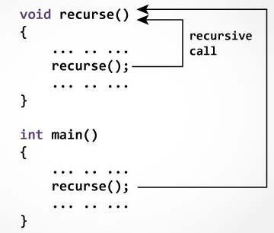
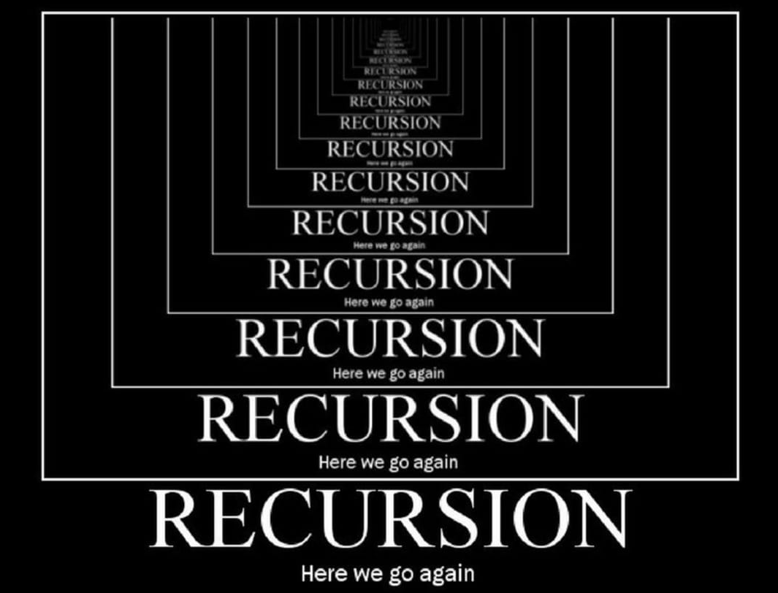
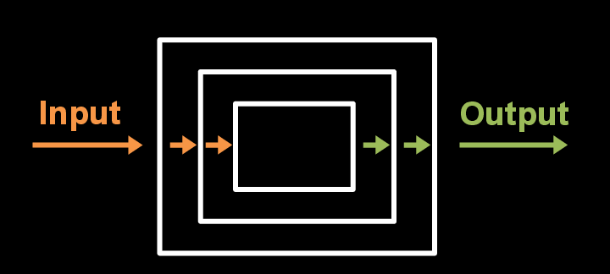
Recursion

Slide 5
Recursion
Every recursive function call creates new fresh instance of the function with different parameters’ values.
The recursion step executes while the original call to the function is paused, waiting in the memory.
void drinkCoffee(cup){
if (!cup.isEmpty()){
cup.takeOneSip(); // Take one sip
drinkCoffee(cup);
}
}

Slide 6

Example 1
Sum the numbers from $n$ to 1. For example, given $n=5$, the sum is $5+4+3+2+1=15$.
We can use loops

Slide 7
Example 1
Sum the numbers from $n$ to 1. For example, given $n=5$, the sum is $5+4+3+2+1=15$.
We can use loops
LOOP
int sum(int n) {
int sum = 0;
while (n > 0) {
sum += n;
n--;
}
return sum;
}

Slide 8

Example 1
Sum the numbers from $n$ to 1. For example, given $n=5$, the sum is $5+4+3+2+1=15$.
We can use loops or recursion
sum(5) =
5 + sum(4) =
5 + 4 + sum(3)=
5 + 4 +3 + sum(2)=
5 + 4 + 3 + 2 + sum(1)= 15

Slide 9
Example 1
Sum the numbers from $n$ to 1. For example, given $n=5$, the sum is $5+4+3+2+1=15$.
We can use loops or recursion
sum(5) =
5 + sum(4) =
5 + 4 + sum(3)=
5 + 4 +3 + sum(2)=
5 + 4 + 3 + 2 + sum(1)= 15
RECURSION
int sum(int n) {
if (n == 1) { // base case
return n;
}
else {
return n + sum(n - 1);
}
}

Slide 10
Example 1
RECURSION
5
int sum(int n) {
if (n == 1) { // base case
return n;
}
else {
return n + sum(n - 1);
}
}

Slide 11
Example 1
RECURSION
5
int sum(int n) {
if (n == 1) { // base case
return n;
}
else {
return n + sum(n - 1);
}
}
5 + sum(4)

Slide 12
Example 1
RECURSION
5
int sum(int n) {
if (n == 1) { // base case
return n;
}
else {
return n + sum(n - 1);
}
}
5 + sum(4)
5 + 4 + sum(3)

Slide 13
Example 1
RECURSION
5
int sum(int n) {
if (n == 1) { // base case
return n;
}
else {
return n + sum(n - 1);
}
}
5 + sum(4)
5 + 4 + sum(3)
5 + 4 + 3 + sum(2)

Slide 14
Example 1
RECURSION
5
int sum(int n) {
if (n == 1) { // base case
return n;
}
else {
return n + sum(n - 1);
}
}
5 + sum(4)
5 + 4 + sum(3)
5 + 4 + 3 + sum(2)
5 + 4 + 3 + 2 + sum(1)

Slide 15
Example 1
RECURSION
5
int sum(int n) {
if (n == 1) { // base case
return n;
}
else {
return n + sum(n - 1);
}
}
5 + sum(4)
5 + 4 + sum(3)
5 + 4 + 3 + sum(2)
5 + 4 + 3 + 2 + sum(1)

Slide 16
Example 1
RECURSION
5
int sum(int n) {
if (n == 1) { // base case
return n;
}
else {
return n + sum(n - 1);
}
}
5 + sum(4)
5 + 4 + sum(3)
1
5 + 4 + 3 + sum(2)
5 + 4 + 3 + 2 + sum(1)

Slide 17
Example 1
RECURSION
5
int sum(int n) {
if (n == 1) { // base case
return n;
}
else {
return n + sum(n - 1);
}
}
5 + sum(4)
3
5 + 4 + sum(3)
1
5 + 4 + 3 + sum(2)
5 + 4 + 3 + 2 + sum(1)

Slide 18
Example 1
RECURSION
5
int sum(int n) {
if (n == 1) { // base case
return n;
}
else {
return n + sum(n - 1);
}
}
5 + sum(4)
6
3
5 + 4 + sum(3)
1
5 + 4 + 3 + sum(2)
5 + 4 + 3 + 2 + sum(1)

Slide 19
Example 1
RECURSION
5
10
int sum(int n) {
if (n == 1) { // base case
return n;
}
else {
return n + sum(n - 1);
}
}
5 + sum(4)
6
3
5 + 4 + sum(3)
1
5 + 4 + 3 + sum(2)
5 + 4 + 3 + 2 + sum(1)

Slide 20
Example 1
15
RECURSION
5
10
int sum(int n) {
if (n == 1) { // base case
return n;
}
else {
return n + sum(n - 1);
}
}
5 + sum(4)
6
3
5 + 4 + sum(3)
1
5 + 4 + 3 + sum(2)
5 + 4 + 3 + 2 + sum(1)

Slide 21
Example 1
15
RECURSION
5
10
int sum(int n) {
if (n == 1) { // base case
return n;
}
else {
return n + sum(n - 1);
}
}
5 + sum(4)
6
3
5 + 4 + sum(3)
1
5 + 4 + 3 + sum(2)
5 + 4 + 3 + 2 + sum(1)

Slide 22

Example 2
Calculate the factorial of a number $n$. For example, the factorial of $n=5=5 ∗4∗3 ∗2 ∗1=120$
We can use loops
LOOP
long factorial_loop(int n){
long res = 1;
while (n > 0) {
res = res * n;
n--;
}
return res;
}

Slide 23

Example 2
Calculate the factorial of a number $n$. For example, the factorial of $n=5=5 ∗4∗3 ∗2 ∗1=120$
We can use loops or recursion
factorial(5) =
5 * factorial(4) =
5 * 4 * factorial(3)=
5 * 4 * 3 * factorial 2)=
5 * 4 * 3 * 2 * factorial(1)=
5 * 4 * 3 * 2 * 1 * factorial(0) = 120

Slide 24
Example 2
Calculate the factorial of a number $n$. For example, the factorial of $n=5=5 ∗4∗3 ∗2 ∗1=120$
We can use loops or recursion
RECURSION
long factorial_recr(int n)
{
if (n == 0) { //base case
return 1;
}
else {
// what if we write n * factorial_recr(n);
long res = n * factorial_recr(n-1);
return res;
}
}
factorial(5) =
5 * factorial(4) =
5 * 4 * factorial(3)=
5 * 4 * 3 * factorial 2)=
5 * 4 * 3 * 2 * factorial(1)=
5 * 4 * 3 * 2 * 1 * factorial(0) = 120

Slide 25
Example 2
Executes factorial(4)

Slide 26
Example 2
Executes factorial(3)

Slide 27
Example 2
Executes factorial(2)

Slide 28
Example 2
Executes factorial(1)

Slide 29
Example 2
Executes factorial(0)

Slide 30
Example 2
returns 1

Slide 31
Example 2
returns factorial(0)

Slide 32
Example 2
returns factorial(1)

Slide 33
Example 2
returns factorial(2)

Slide 34
Example 2
returns factorial(3)

Slide 35
Example 2
returns factorial(4)

Slide 36
Example 2

Slide 37
Exercise 1
What is wrong with the following function?
int factorial(int n)
{
return n * factorial(n - 1);
}

Slide 38
Exercise 1
What is wrong with the following function?
There is no base case. The function runs infinitely and causes the stack overflow.
int factorial(int n)
{
return n * factorial(n - 1);
}

Slide 39
Exercise 2
Show the output of the following programs and identify base cases and recursive calls.
int f(int n)
{
if (n == 1)
return 1;
else
return n - f(n - 1);
}
int main() {
printf("%d\n",f(5));
}
void f(int n)
{
if (n > 0)
{
printf("%d\n",n % 10);
f(n / 10);
}
}
int main() {
f(1234567);
}

Slide 40

Exercise 3
Write a recursive mathematical definition for computing $2^{n}$ for a positive integer $n$.

Slide 41

Exercise 4
Write a recursive mathematical definition for computing $x^{n}$ for a positive integer $n$ and a real number $x$.

Slide 42

Example 3 - Fibonacci Numbers
Calculate Fibonacci series. The Fibonacci series is a series begins with 0 and 1, and each subsequent number is the sum of the previous two numbers.
The Fibonacci series may be defined recursively as follows:
$fibonacci(0) = 0$
$fibonacci(1) = 1$
$fibonacci(n) = fibonacci(n – 1) + fibonacci(n – 2)$

Slide 43

Example 3 - Fibonacci Numbers
Calculate Fibonacci of 7 recursively.
The rule is $fibonacci(n) = fibonacci(n – 1) + fibonacci(n – 2)$
fib(7) = fib(6) + fib(5)

Slide 44
Example 3 - Fibonacci Numbers
Calculate Fibonacci of 7 recursively.
The rule is $fibonacci(n) = fibonacci(n – 1) + fibonacci(n – 2)$
fib(7) = fib(6) + fib(5)
fib(6) = fib(5) + fib(4)
fib(5) = fib(4) + fib(3)

Slide 45
Example 3 - Fibonacci Numbers
Calculate Fibonacci of 7 recursively.
The rule is $fibonacci(n) = fibonacci(n – 1) + fibonacci(n – 2)$
fib(7) = fib(6) + fib(5)
fib(6) = fib(5) + fib(4)
fib(5) = fib(4) + fib(3)
fib(5) = fib(4) + fib(3)
fib(4) = fib(3) + fib(2)

Slide 46
Example 3 - Fibonacci Numbers
Calculate Fibonacci of 7 recursively.
The rule is $fibonacci(n) = fibonacci(n – 1) + fibonacci(n – 2)$
fib(7) = fib(6) + fib(5)
fib(6) = fib(5) + fib(4)
fib(5) = fib(4) + fib(3)
fib(5) = fib(4) + fib(3)
fib(4) = fib(3) + fib(2)
fib(4) = fib(3) + fib(2)
fib(3) = fib(2) + fib(1)

Slide 47
Example 3 - Fibonacci Numbers
Calculate Fibonacci of 7 recursively.
The rule is $fibonacci(n) = fibonacci(n – 1) + fibonacci(n – 2)$
fib(7) = fib(6) + fib(5)
fib(6) = fib(5) + fib(4)
fib(5) = fib(4) + fib(3)
fib(5) = fib(4) + fib(3)
fib(4) = fib(3) + fib(2)
fib(4) = fib(3) + fib(2)
fib(3) = fib(2) + fib(1)
fib(3) = fib(2) + fib(1)
fib(2) = fib(1) + fib(0)

Slide 48
Example 3 - Fibonacci Numbers
Calculate Fibonacci of 7 recursively.
The rule is $fibonacci(n) = fibonacci(n – 1) + fibonacci(n – 2)$
fib(7) = fib(6) + fib(5)
fib(6) = fib(5) + fib(4)
fib(5) = fib(4) + fib(3)
fib(5) = fib(4) + fib(3)
fib(4) = fib(3) + fib(2)
fib(4) = fib(3) + fib(2)
fib(3) = fib(2) + fib(1)
fib(3) = fib(2) + fib(1)
fib(2) = fib(1) + fib(0)
fib(2) = fib(1) + fib(0)
1

Slide 49
Example 3 - Fibonacci Numbers
Calculate Fibonacci of 7 recursively.
The rule is $fibonacci(n) = fibonacci(n – 1) + fibonacci(n – 2)$
fib(7) = fib(6) + fib(5)
fib(6) = fib(5) + fib(4)
fib(5) = fib(4) + fib(3)
fib(5) = fib(4) + fib(3)
fib(4) = fib(3) + fib(2)
fib(4) = fib(3) + fib(2)
fib(3) = fib(2) + fib(1)
fib(3) = fib(2) + fib(1)
fib(2) = fib(1) + fib(0)
fib(2) = fib(1) + fib(0)
1
1
0

Slide 50
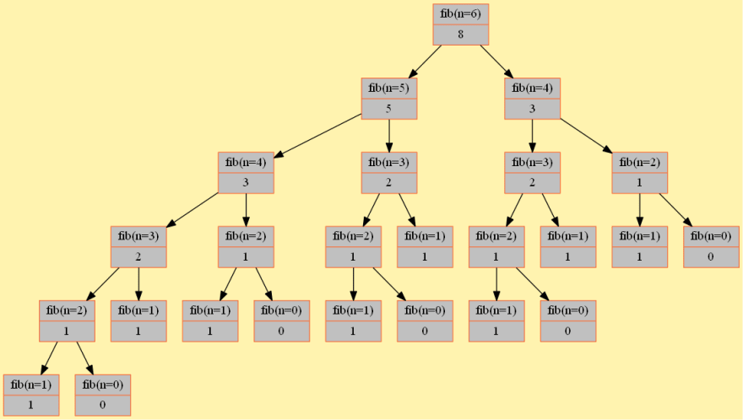
Example 3 - Fibonacci Numbers

Slide 51
Example 3 - Fibonacci Numbers

Slide 52
Example 3 - Fibonacci Numbers
Calculate Fibonacci of 7 recursively.
The rule is $fibonacci(n) = fibonacci(n – 1) + fibonacci(n – 2)$
LOOP
RECURSION
int fib_loop(int n)
{
int fib0 = 0;
int fib1 = 1;
int next;
int i;
for (i = 2; i <= n; i++) {
next = fib0 + fib1;
fib0 = fib1;
fib1 = next;
}
return next;
}
int fib_recr(int n)
{
if (n == 0) {//base case 1
return 0;
}
else if (n == 1) {//base case 2
return 1;
}
else {
return fib_recr(n - 1) + fib_recr(n - 2);
}
}

Slide 53
Exercise 5
What is wrong in the following function?
void f(double n)
{
if (n != 0)
{
printf("%d ",n);
f(n / 10);
}
}
int main() {
f(1234567);
}

Slide 54
TASK 1
Write a recursive function to check if a string is a palindrome or not.

Slide 55

TASK 2
(Compute greatest common divisor using recursion) The $gcd⁡(m, n)$can also be defined recursively as follows:
If $m \% n$ is $0$, then $gcd⁡(m, n)$ is n.
Otherwise, $gcd⁡(m, n)$ is $gcd⁡(n, m \% n)$.

Slide 56
Course Mind Map
C programming Course
Introduction to Computers, the Internet and the Web
Basics of C language
Problem Solving
Conditions
Loops
Arrays
Functions
Recursion

